Slide 1
White title slide
Replicated Database: cRaft++
CS 739 Project 2
Selvaraj Anandaraj, Deep Jiten Machchhar, Vishnu Ramadas

Slide 2
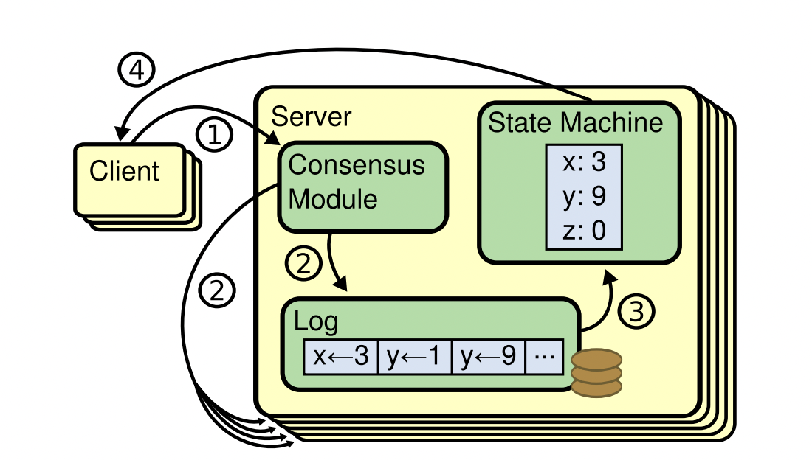
Text slide: 1 column
cRaft++ : A Raft based Replicated Database
Database with Get/Put Key-Value support
Have a strong leader at any instant
Implements leader election
Strongly consistent
Persistent state machine
Ensures safety and availability and understandability

Slide 3
Text slide: 1 column
cRaft++ : A Raft based Replicated Database
Client
Uses a returned active leader to access next time
Does a round-robin try on hitting a failed server
Server
Maintains the key-value store and log persistently
Detects leader failures and initiates election automatically
Modularized C++ implementation utilizing its features

Slide 4
Text slide: 1 column
cRaft++ : A Raft based Replicated Database
What’s new?
Multi-threaded execution of RPC’s
Pipelining log entry execution with RPC response
Log cache on leaders to reduce disk access
Test cases?
Ensure log consistency checks
Ensure the election and commit rule
Ensure log rollback and pruning

Slide 5
Text slide: 1 column
Multi-Threaded Execution of RPC’s
cRaft++ uses RPCs for server-server log replication, heartbeats and elections
No concept of sequential RPCs across servers
Each fellow server has its own thread for each RPC type
Dependencies for strong consistency distilled for maximum multi-threading
Have self-contained master-subordinate threads orchestrating each other
Threads smart enough to kill itself based on state changes

Slide 6
Text slide: 1 column
Pipelining Execution with RPC Response
cRaft++ overlaps RPC response with execution on followers
Leader gets instant ack on a consistent log append
Helps overlap computation with communication
Increases compute and network utilization
Benefit from the fact that followers state machine execution needed for client

Slide 7
Text slide: 1 column
Log Cache
cRaft++ uses a volatile log for intermediate accesses
Volatile log is a system-maintained SW cache to avoid disk accesses
Motivation: Need to access log for execution, consistency checks, log rollback, etc.
Would be smart to make this log in memory until needed
Lifetime of a volatile log entry is from Log Append to Entry to execution (which is optimistically enough!)

Slide 8
Text slide: 1 column
Test Case 1:
Check Leader Election, Replication and Election Rule
Bring all servers up, wait for a leader!
Transact to the leader to build and replicate log
Crash leader, wait for a new leader, resurrect the dead
Transact to the new leader
Check for synchronized log replication
Demo

Slide 9
Text slide: 1 column
Test Case 2:
Check Log Consistency Check and Log Bring-up
Bring all servers up, wait for a leader!
Transact to the leader to build and replicate log
Crash follower
Transact to the new leader
Bring back the follower, log needs to be built again!
Check for synchronized log replication
Demo

Slide 10
Text slide: 1 column
Test Case 3:
Check Log Commit Rule
Bring all servers up, wait for a leader!
Transact to the leader to build and replicate log (TX 1)
Crash leader (S A)
Transact to the new leader (S B, TX 2)
Crash the new leader (S B)
Resurrect the former leader which becomes follower (S A)
At this point, commit rule will stop TX2 to commit in S A
Transact to the new leader (S C), now TX2 will commit in A
Demo

Slide 11
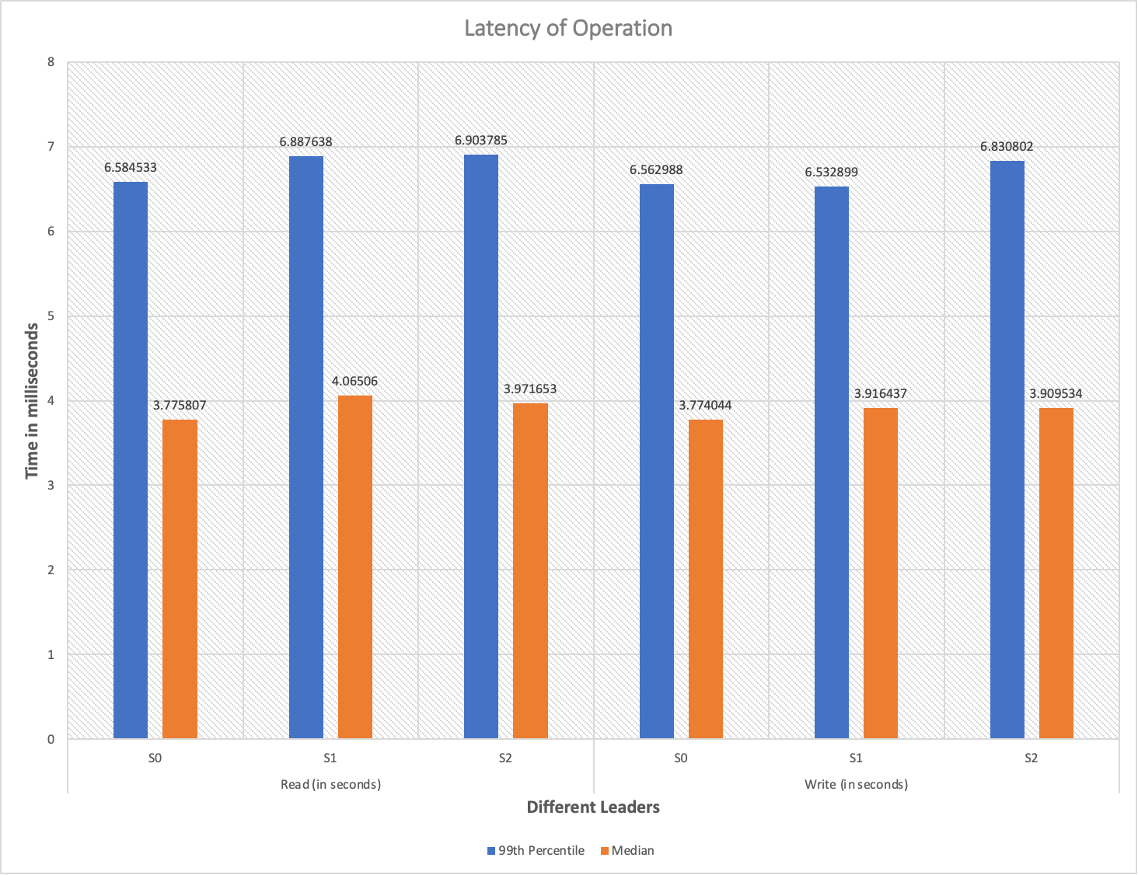
Text slide: 1 column
Results: Server-wise Read/Write Latency

Slide 12
Text slide: 1 column
Results
Execution time on follower servers is less than 2 milliseconds; This is the time we save through overlapping compute with communication
Heartbeat should be less than Election Timeout by 50 millisecond to work seamlessly. Hypothesis: We believe more leader elections to take place if Election Timeout and Heartbeat timeout are close.

Slide 13
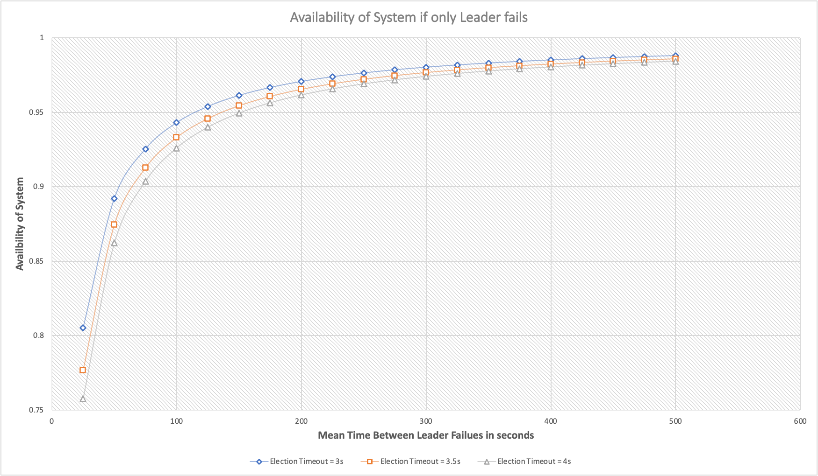
Text slide: 1 column
Results: System Availability

Slide 14
Black section break slide
Thank you!

